Slide 1
WPL – Mini-Project
SY B.Tech Computer Engineering Semester IV ( 2024-25)
Aayush Hardas 16010123013
Aditya Sontakke 16010123022
Division A
Batch A1

Slide 2
Theme chosen for Project
Climate Control and Sustainability
Our mini project is based on the theme "Climate Control", aligned with the United Nations Sustainable Development Goals (SDGs), :
SDG 11: Sustainable Cities and Communities
SDG 13: Climate Action

Slide 3
Need Statement
- Climate change is accelerating, yet public awareness and action remain insufficient.
- There is a need for digital solutions that promote eco-conscious behavior and real-time environmental insights.
- Our platform addresses the information-action gap by guiding users toward sustainable practices.
- It empowers individuals and communities to take part in climate control efforts.

Slide 4
Problem Statement
To develop an interactive web platform that promotes climate control and sustainability by providing real-time environmental data, awareness tools, and a repository of local eco-friendly practices, thus encouraging users to actively participate in climate action.

Slide 5
Objective
1. Develop a web-based application focused on climate awareness and control
2. Promote green practices through awareness page
3. Include a real-time environmental data dashboard (weather, AQI)
4. Create a repository of sustainable practices in Indian cities/villages
5. Encourage behavioral change through gamified actions and checklists

Slide 6
Constraint
- Limited access to real-time environmental sensors
- Dependence on external APIs for data (AQI, weather)

Slide 7
Functions
- User Authentication: Secure login system
- Dashboard: Homepage
- Live Climate Data (AQI, Temperature)
- Educational Content: Awareness
- Sustainable Practices Database: Contributions from Indian regions
- Actions: Actions for eco-friendly behavior
- Feedback Form: User suggestions and improvements
- Contact Form
- Admin Login to Modify Database and Administrative Tasks

Slide 8
Time line Chart
Week 1-2: Research, Planning and Figma
Week 3-4: Frontend Design
Week 5-6: Backend Integration, Schema and Database
Week 7: Sustainable Practices Dataset
Week 8: Testing and Feedback
Week 9: Final Edits and Presentation

Slide 9
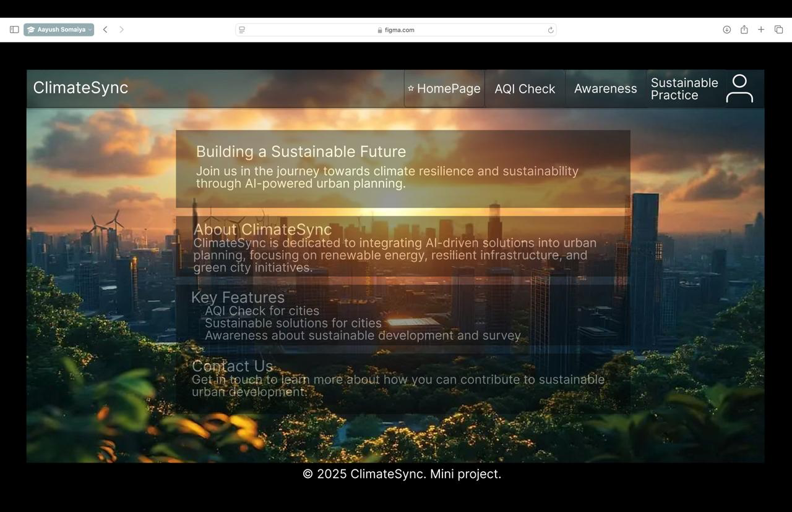
Conceptual Designs

Slide 10
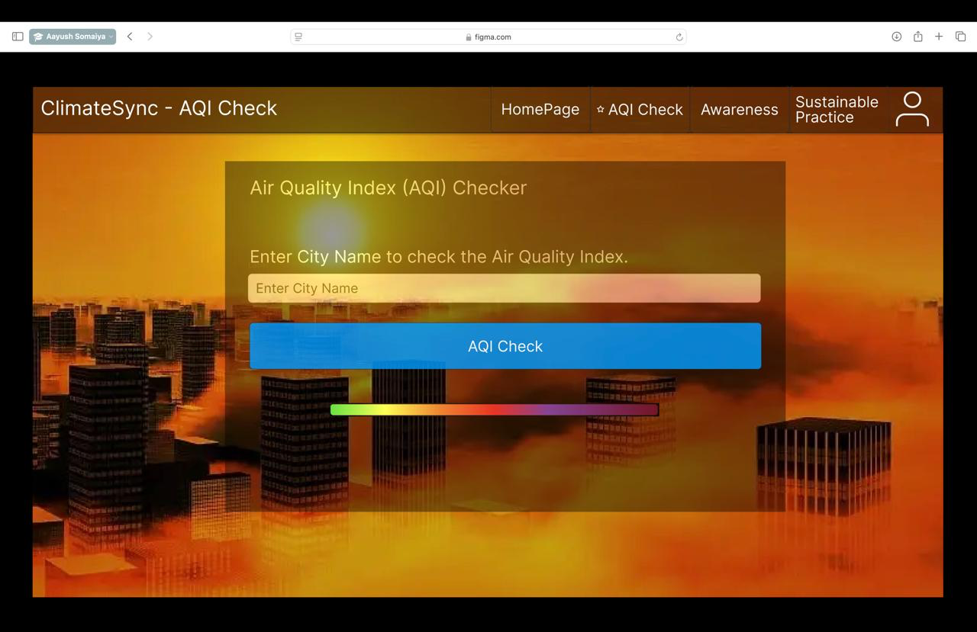
Conceptual Designs

Slide 11
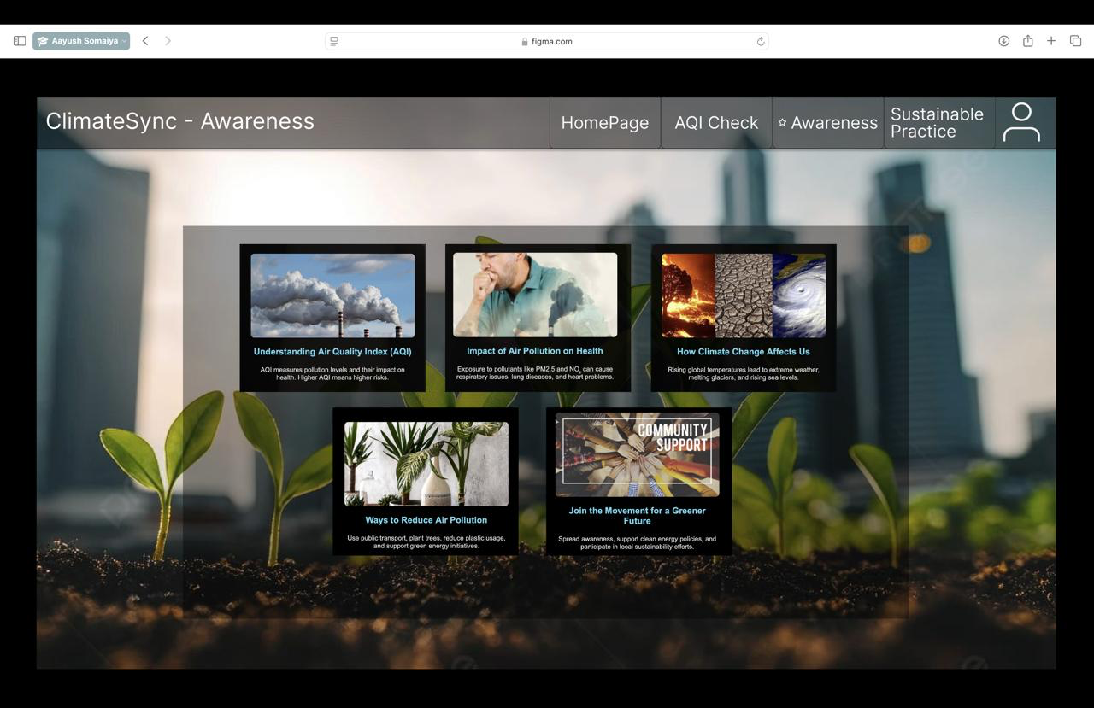
Conceptual Designs

Slide 12
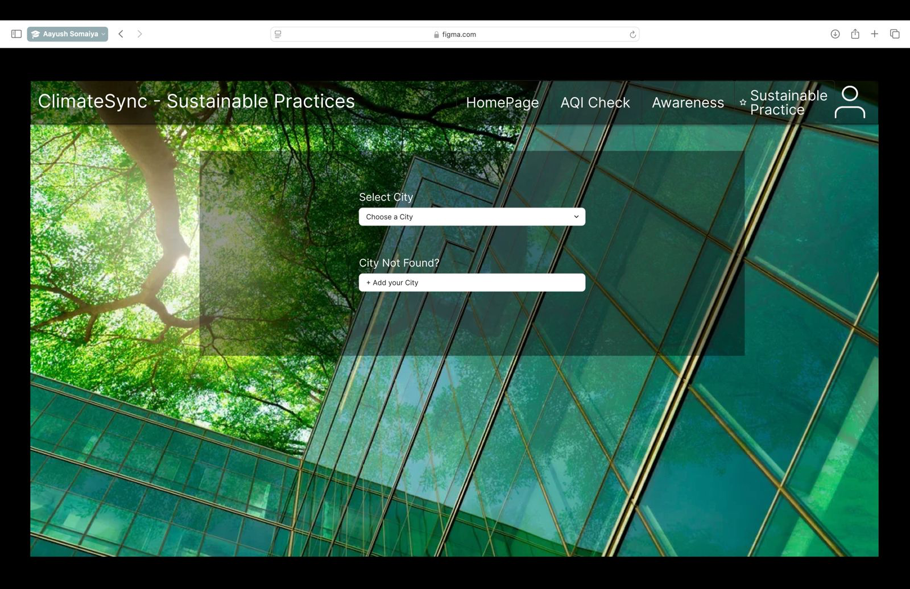
Conceptual Designs

Slide 13
Results
- Developed a fully working frontend-backend application
- Integrated weather and AQI API
- Built a database with 30+ sustainable practices entries
- Developed a responsive and visually engaging UI
- Administrative Login

Slide 14
Future Scope
- Add multilingual support to reach a broader audience
- Launch a mobile application version
- Add community features like forums and local events
- Collaborate with NGOs and civic bodies for real-world impact

Slide 15
Conclusion and your learnings
- Learned HTML, CSS, PHP, JavaScript, Bootstrap
- Gained experience in API integration and data visualization
- Understood the importance of sustainability and community involvement
- Improved skills in teamwork, research, and project management

Slide 16
References
1. UN SDG 11 - Climate Action: https://sdgs.un.org/goals/goal11
2. UN SDG 13 - Climate Action: https://sdgs.un.org/goals/goal13
3. Central Pollution Control Board (CPCB): https://cpcb.nic.in/
4. Indian Ministry of Environment Reports: https://moef.gov.in/
5. APIs used: AQICN : https://aqicn.org
WeatherAPI : https://www.weatherapi.com

Slide 17


